Slide 1
Meditation App
By: Kyle Wynne

Slide 2
Introduction
This app will aid people studying for exams by offering calming / lofi study beats
This app will also help someone looking to meditate by facilitating the meditation process and provide a helpful setting for the person who will be meditating

Slide 3
Motivation
With Finals Season Going on and the holiday crunch going on at work many people need to destress and focus. By combining both these activities into a single app people can have a hub to spend their work and meditation time.

Slide 4
User Stories
Potential Users:
Students needing to study for finals
People working a 9-5
People who are stressed out and in need of stress relief
People looking to destress through meditation

Slide 5
Ideate
Figma Prototype: https://www.figma.com/file/yy410AGssFk4NyyMnRjAi9/IOS-Final?type=design&node-id=0%3A1&mode=design&t=Shjmp1CnWfl2XxXz-1

Slide 6
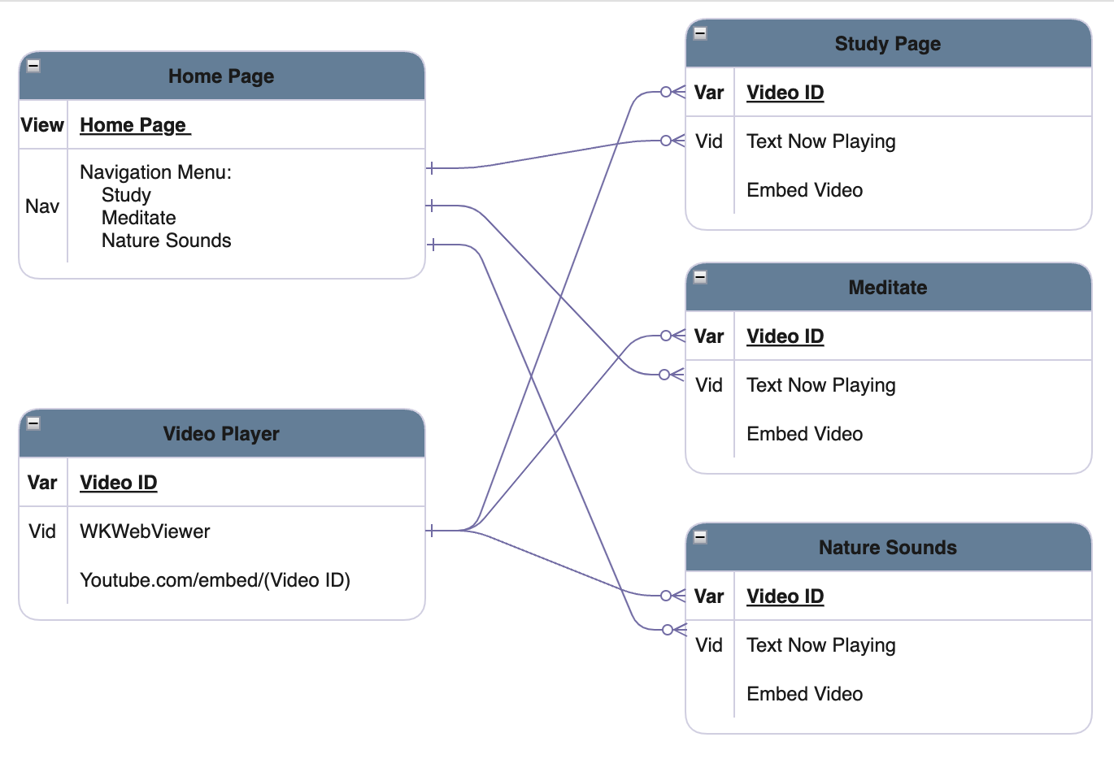
App Architecture

Slide 7
Prototype

Slide 8
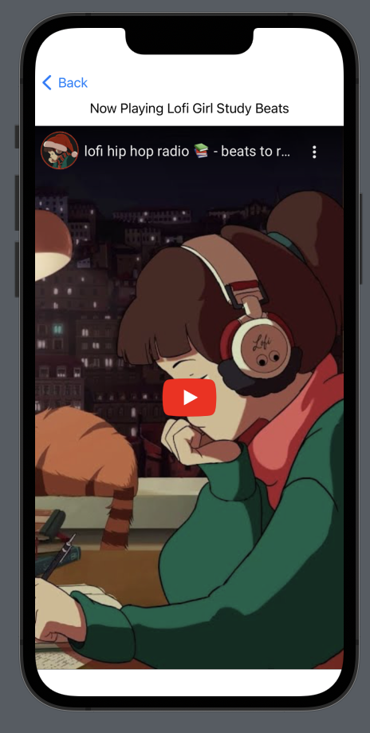
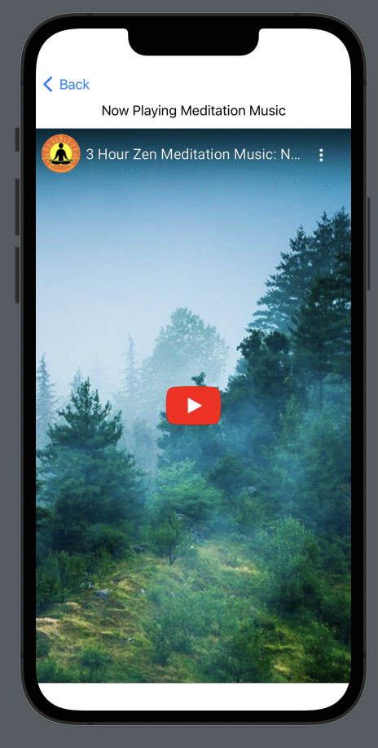
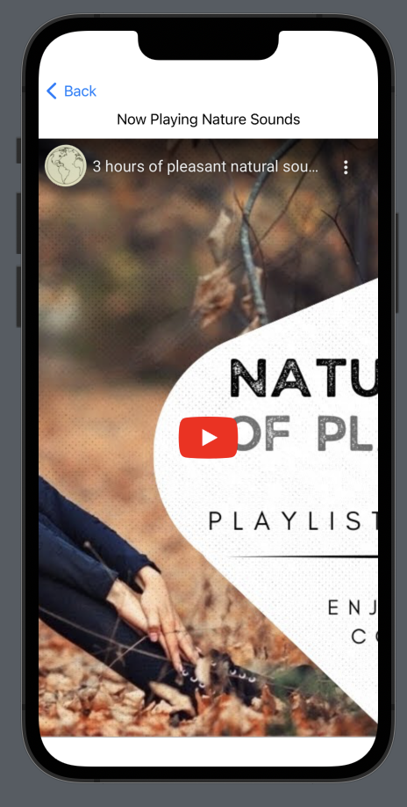
Design Heuristics
Consistency and Standards
All 3 endpoint interfaces have the same design with different data
Visibility of System Status
Uses the Play button and Now Playing to indicate whether the video is playing

Slide 9
IOS Human GuideLines
4 Human Guidelines Followed In this App:
Simplicity
Prefer simplified gestures for common interactions
Resist the temptation to display your logo throughout your app or game unless it’s essential for providing context.
Use color sparingly in non game apps.

Slide 10
Conclusion
The main challenge in this project was the advanced feature
embedding Videos From youtube into an App
In the future this app could be improved to house interactive meditation
The app could also be improved to house Guided Meditation Sessions for Its Users
Currently the main limitation of this is that I do not have the knowledge to create a set of meditation routines and would need to contact an expert

